Slide 1

AI/ML for 5G-Energy Consumption Modelling by ITU AI/ML in 5G Challenge
Predicting energy consumption of different 5G products?
Presenters
Krishna Priya | Rajat Ranjan
krishnapriyakejriwal@gmail.com | rajat5ranjan@gmail.com
Farzi Data Scientists

Slide 2
Agenda
Problem Understanding
Data Understanding
Data Pre-Processing
Application of Learnings
Model Building & Evaluation
INTRODUCTION
Notes:
Learnings & how their approach can be applied to different use cases

Slide 3
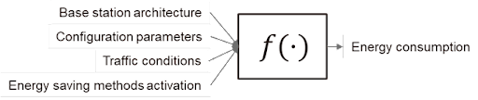
Problem Understanding
Challenge
Base station energy consumption depends on multiple factors, such as specific architecture
configuration parameters (e.g., number of operated carriers, bandwidth, transmit power),
traffic conditions (e.g., number of allocated physical resource blocks), and the activation of
energy-saving methods. To reduce network energy consumption, it is crucial to optimize
base station parameters and energy-saving methods. This requires a deep understanding
of how these parameters and methods impact the energy consumption of different base stations.
Objectives
Energy Consumption Estimation
Generalization Across Product
Generalization Across Configs
Estimation of the energy consumed by different base station products.
Generalization across different base station products. It must estimate the energy consumption of a new base station based on measurements collected from existing ones
Generalization across different base station configurations It must predict the energy consumption of newly configured parameters real network configuration parameters

Slide 4
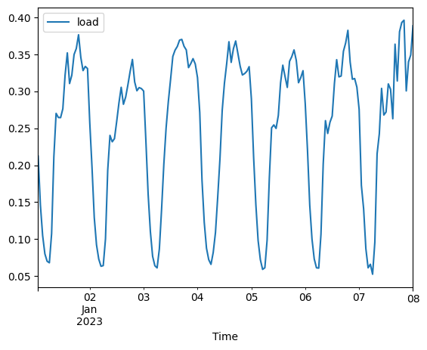
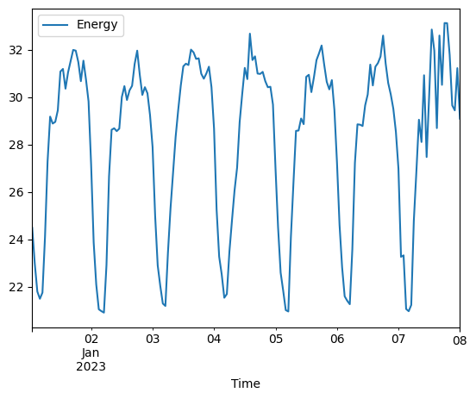
Data Understanding & EDA
Raw Features
load, Timestamp, ESMode1, ESMode2,
ESMode3, ESMode5, RUType,
Mode, Frequency, Bandwidth, Antennas, TXpower
Target Variable
Energy
It pronounced relationship between load and energy consumption, particularly concerning the hour of the day. This suggests the presence of seasonal components associated with these variables, warranting a closer examination of temporal patterns

Slide 5
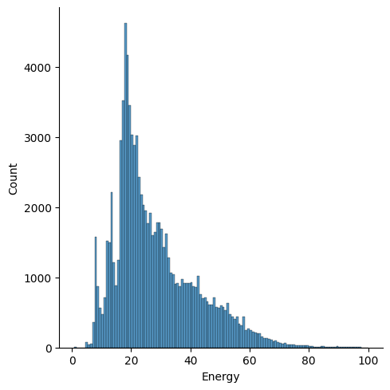
Data Understanding & EDA
Raw Features
load, Timestamp, ESMode1, ESMode2,
ESMode3, ESMode5, RUType,
Mode, Frequency, Bandwidth, Antennas, TXpower
Target Variable
Energy
It pronounced relationship between load and energy consumption, particularly concerning the hour of the day. This suggests the presence of seasonal components associated with these variables, warranting a closer examination of temporal patterns
It exhibits notable skewness in the distribution of energy values, hinting at the need for potential data transformations to enhance model performance.

Slide 6
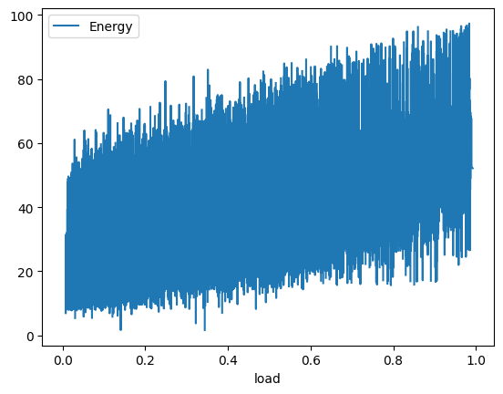
Data Understanding & EDA
Raw Features
load, Timestamp, ESMode1, ESMode2,
ESMode3, ESMode5, RUType,
Mode, Frequency, Bandwidth, Antennas, TXpower
Target Variable
Energy
It pronounced relationship between load and energy consumption, particularly concerning the hour of the day. This suggests the presence of seasonal components associated with these variables, warranting a closer examination of temporal patterns
It illustrates a linear relationship between load and energy, offering further insights into the dynamics governing these crucial factors.
It exhibits notable skewness in the distribution of energy values, hinting at the need for potential data transformations to enhance model performance.

Slide 7
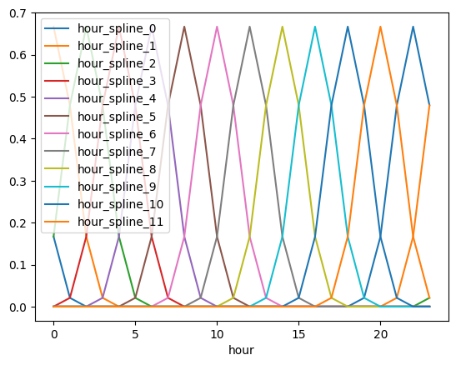
Data Understanding & EDA
Time Stamp derived Features
day, weekday_number, hour, hour_spline_0, hour_spline_1, hour_spline_2, hour_spline_3, hour_spline_4, hour_spline_5, hour_spline_6, hour_spline_7, hour_spline_8, hour_spline_9, hour_spline_10, hour_spline_11
We utilized features like Hour to generate their corresponding spline representations. This approach not only contributes to the refinement of feature encoding but also introduces periodicity into the expanded feature set

Slide 8
Data Understanding & EDA
day, weekday_number, hour, hour_spline_0, hour_spline_1, hour_spline_2, hour_spline_3, hour_spline_4, hour_spline_5, hour_spline_6, hour_spline_7, hour_spline_8, hour_spline_9, hour_spline_10, hour_spline_11
load_T-1, ESMode1_T-1, ESMode2_T-1, ESMode3_T-1, ESMode6_T-1, Energy_T-1,
load_T-2, ESMode1_T-2, ESMode2_T-2, ESMode3_T-2, ESMode6_T-2, Energy_T-2,
load_T-3, ESMode1_T-3, ESMode2_T-3, ESMode3_T-3, ESMode6_T-3, Energy_T-3, Time_T-1_hours_elapsed, Time_T-2_hours_elapsed, Time_T-3_hours_elapsed
To address the challenge of Target Leakage, we meticulously engineered lag features that inherently exclude the use of future data. The shift function with respect to time (T-1, T-2 and T-3), effectively mitigated the risk of leveraging future data values.
Historical Lags features for each BS
The time-based lagging, implemented via the shift function with respect to time (T-1, T-2 and T-3), effectively mitigated the risk of leveraging future data values. We selected till T-3 window based on ACF and PCF function
We utilized features like Hour to generate their corresponding spline representations. This approach not only contributes to the refinement of feature encoding but also introduces periodicity into the expanded feature set

Slide 9
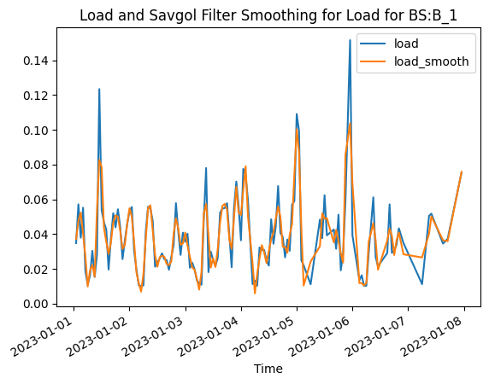
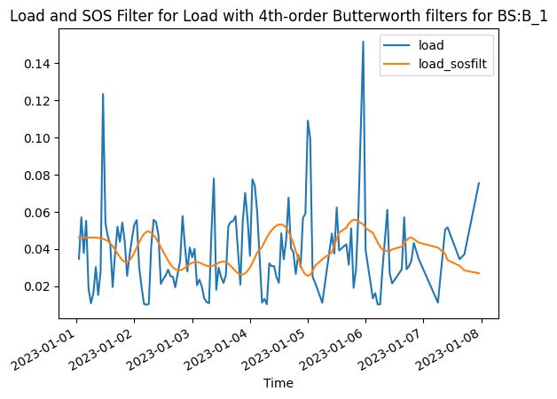
Data Understanding & EDA
load_smooth, load_diff, load_diff2, load_diff3, load_sosfiltfilt, load_sosfilt
day, weekday_number, hour, hour_spline_0, hour_spline_1, hour_spline_2, hour_spline_3, hour_spline_4, hour_spline_5, hour_spline_6, hour_spline_7, hour_spline_8, hour_spline_9, hour_spline_10, hour_spline_11
load_T-1, ESMode1_T-1, ESMode2_T-1, ESMode3_T-1, ESMode6_T-1, Energy_T-1,
load_T-2, ESMode1_T-2, ESMode2_T-2, ESMode3_T-2, ESMode6_T-2, Energy_T-2,
load_T-3, ESMode1_T-3, ESMode2_T-3, ESMode3_T-3, ESMode6_T-3, Energy_T-3, Time_T-1_hours_elapsed, Time_T-2_hours_elapsed, Time_T-3_hours_elapsed
To address the challenge of Target Leakage, we meticulously engineered lag features that inherently exclude the use of future data. The shift function with respect to time (T-1, T-2 and T-3), effectively mitigated the risk of leveraging future data values.
Signal Processed Features
The time-based lagging, implemented via the shift function with respect to time (T-1, T-2 and T-3), effectively mitigated the risk of leveraging future data values.
We utilized features like Hour to generate their corresponding spline representations. This approach not only contributes to the refinement of feature encoding but also introduces periodicity into the expanded feature set
Our feature engineering endeavors extended into the realm of signal processing like Savitzky-Golay Filtering & Second-Order Section (SOS) Filtering

Slide 10
Data Pre Processing
Pre-Processing
Feature Engineering
Cross Validation
Raw Initial Data
Data Cleaning
Data Transformation for Time Stamp features
GroupKfold Using Base Station Grouping
Ordinal encoding of Base Station Specific Information
Periodic Spline Transformation of Hour to get expanded set of features
Feature Bins of Time specific attribute such as Load
Best Suited Strategy to target Base stations with History and new Base Station considering its attributes considering all objectives
Cell Name information and other attributes
Lag Features for Load, ESModes and other Base station specific variables such as Bandwidth etc
Signal Processing for Load using Savitzky-Golay Filtering & SOS Butterworth Filtering to capture signal dynamics while capturing causality in Time Series
Creation of static Date Time Features from Time

Slide 11
Data Pre Processing
Feature Engineering
No Future Data
Cross Validation
Data Transformation for Time Stamp features
To address the challenge of Target leakage, we took a strategic approach to feature creation. We meticulously engineered time-based features that inherently exclude the use of future data.
GroupKfold Using Base Station Grouping
Periodic Spline Transformation of Hour to get expanded set of features
Feature Bins of Time specific attribute such as Load
Best Suited Strategy to target Base stations with History and new Base Station considering its attributes considering all objectives
Lag Features for Load, ESModes and other Base station specific variables such as Bandwidth etc
Signal Processing for Load using Savitzky-Golay Filtering & SOS Butterworth Filtering to capture signal dynamics while capturing causality in Time Series

Slide 12
Model Building and Evaluation
Cross Validation
Final Thoughts
FAST AI ANN Model
Local CV MAE (0.68) + MAPE (0.031)
We tried various Models out of which finally, we selected Keras ANN model was selected as the final model due to its better performance in the local Group K Fold cross validation and public leaderboard.
GroupKfold Using Base Station Grouping
5 Layers (256 x 512 x 1024 x 512 x 256)
Private WMAPE 0.0549
54 final features
MAE + MAPE
ReLU
Best Suited Strategy to target Base stations with History and new Base Station considering its attributes considering all objectives
Keras ANN Model
Local CV MAE (0.67) + MAPE (0.026)
5 Layers (256 x 512 x 1024 x 512 x 256)
Private WMAPE 0.0435
54 features (3 Embedding Layers + 51 Dense Features
SiLU
MAE + MAPE

Slide 13
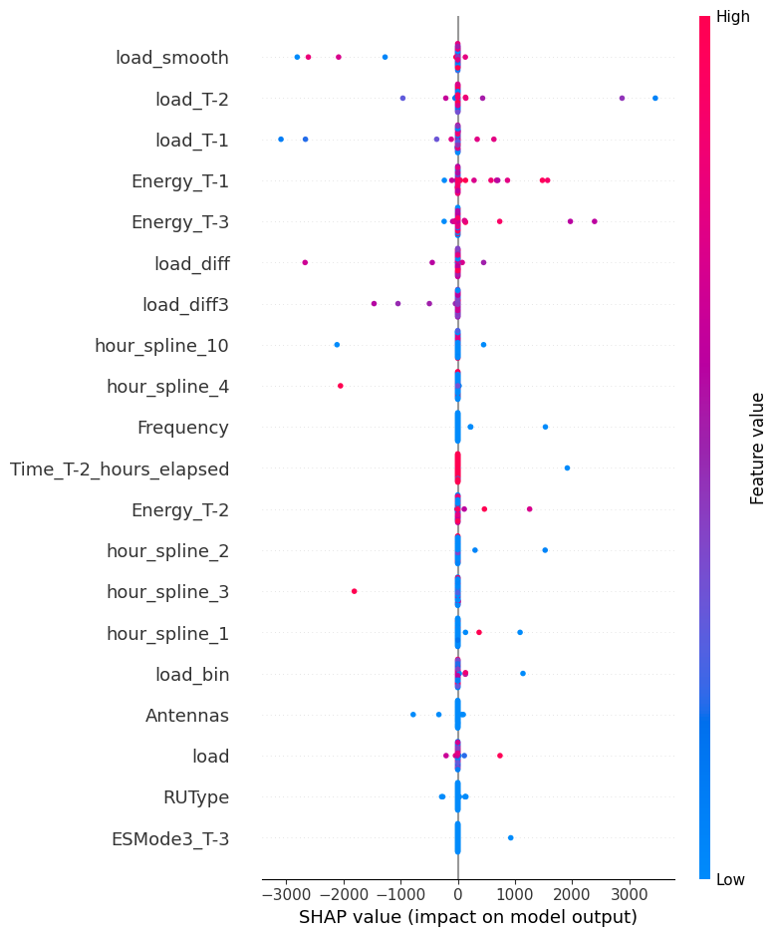
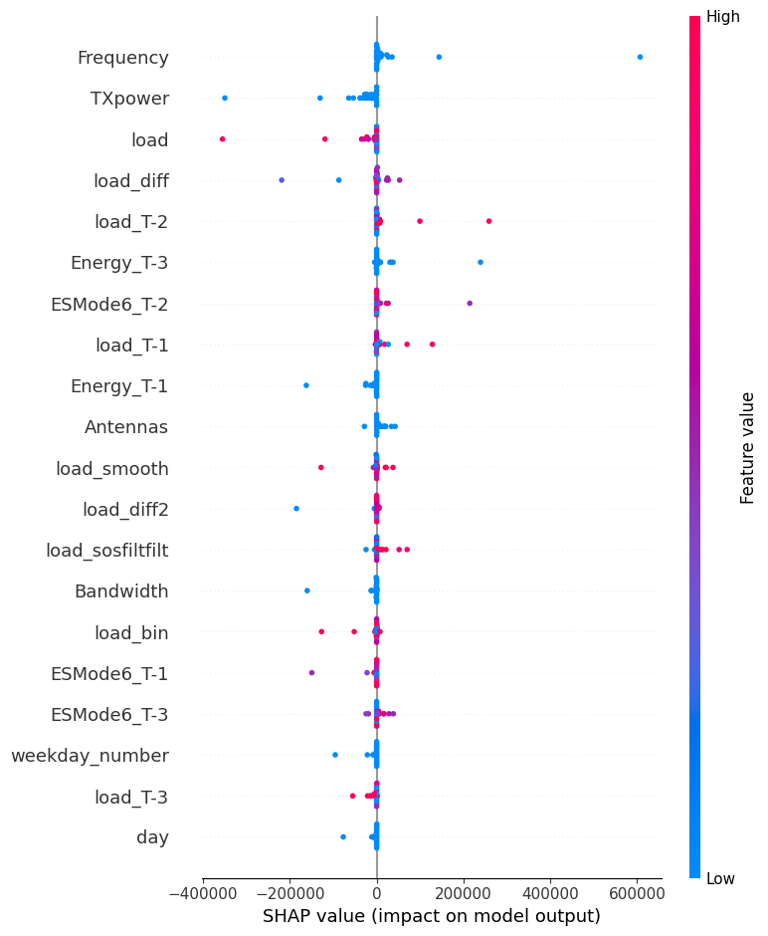
Model Explainaibility
EXISTING
NEW
BS -143
Understanding SHAP for NEW & EXISTING Base Stations
BS -1016
HIGH impact on the model, since load_smooth with high and low values
HIGH values of Load tend to have LOW impact (though good importance), but HIGH values of load_T-2 and load_diff have a very impact on model output

Slide 14
Model Explainaibility
EXISTING
NEW
BS -143
Understanding SHAP for NEW & EXISTING Base Stations
BS -1016
LOW values of Frequency have high impact on the model output,
hour_spline features which are also indicating good model insights

Slide 15
Model Explainaibility
EXISTING
NEW
BS -143
Understanding SHAP for NEW & EXISTING Base Stations
BS -1016
Energy consumption or (value=0 for Lagged Variables), therefore we can see that the values of all Energy Lagged values such as Energy_T-1, Energy_T-2 and so on have very low Values
The interesting part of this analysis is the importance of Energy_T-1, Energy_T-2 and Energy_T-3 for which HIGH values for Energy_T-1 has a very good impact

Slide 16
Applications of Learning & Future Work
Machine Learning Advancements
Resource Allocation Strategies
Ethical and Societal Considerations
Dynamic Network Configuration
Energy Efficiency Optimization
Real-world Deployments and Testing

Slide 17
Thank You !!
Questions?

